Slide 1
Database Management System Furniture Management System

Slide 2
Project analysis slide 2
Introduction
A Database Management System is a fundamental tool for efficiently organizing, storing, and managing data in a structured and secure manner, making it an indispensable component of modern information systems and applications.
Furniture serves various essential purposes in our lives, making it a necessity for both functional aesthetic reasons. Here are some of the key reasons why furniture is a necessity:
Comfort and Rest: Furniture, such as sofas, beds, and chairs, provides a comfortable and supportive place for people to rest and relax. Quality furniture enhances our comfort and helps us unwind after a long day.
2.Storage and Organization: Furniture like cabinets, dressers, and shelves offer storage solutions, helping us keep our living spaces tidy and well-organized. They allow us to store clothing, personal items, books, and more.
3.Work and Productivity: Desks, office chairs, and workstations are essential for creating a productive work environment, whether at home or in the office. These pieces of furniture enable us to focus on tasks and be more efficient.
4.Dining and Socializing: Dining tables and chairs facilitate family meals and gatherings with friends. They provide a space for people to come together, share meals, and socialize.

Slide 3
Name of the tables are:
1.Customer Order
2. Customer
3. Payment
4. Category
5. Furniture
6. Order Details

Slide 4
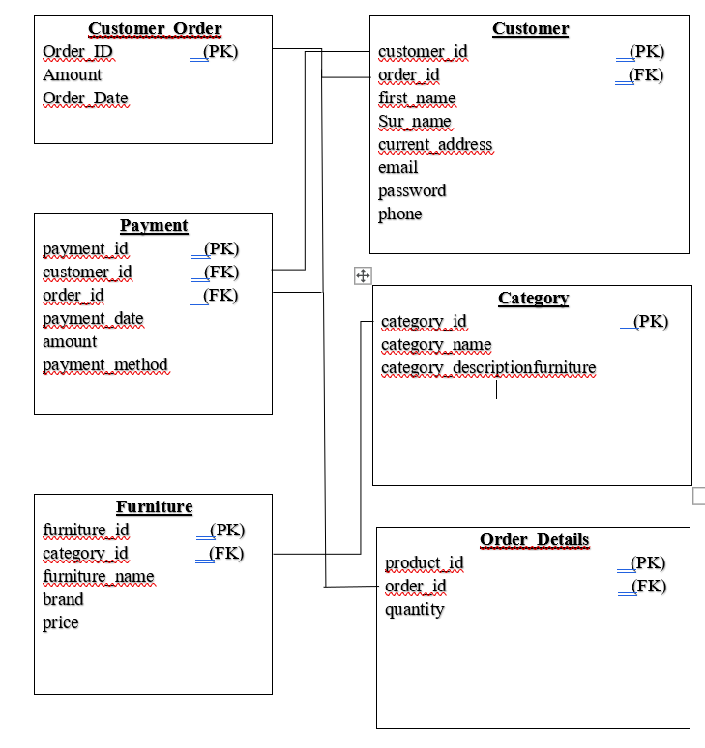
Schema Diagram of Furniture Management System

Slide 5
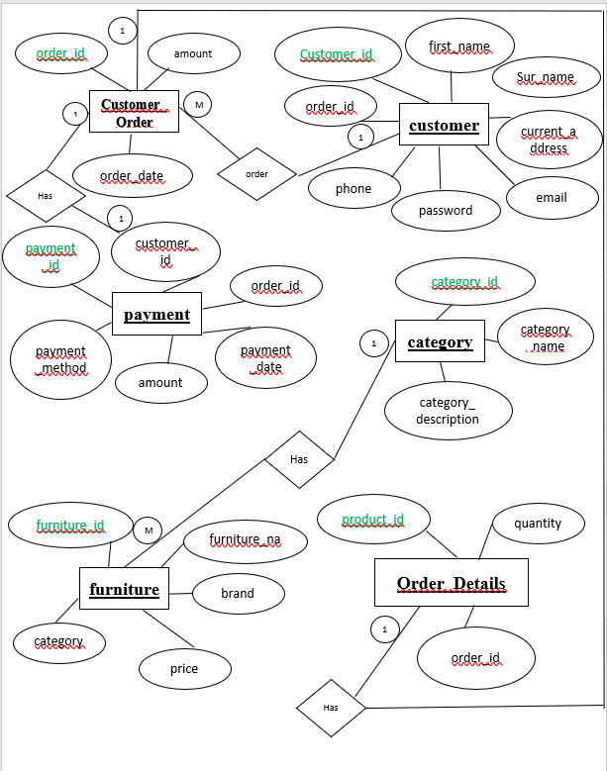
The ER diagram of my project is given below:

Slide 6

Project analysis slide 2
ORDER DETAILS TABLE
Product ID | Quantity | Order ID
1 | 2 | 1
2 | 1 | 2
3 | 4 | 3
4 | 1 | 4
6 | 2 | 6
7 | 3 | 9
10 | 1 | 10

Slide 7
Project analysis slide 2
FURNITURE TABLE
Furniture ID | Furniture Name | Category ID | Brand | Price
1 | Sofa | 1 | RFL | 1000
2 | Bed | 2 | RFL | 600
3 | Dining Table | 3 | PARTEX | 600
4 | Desk | 4 | OTIOBI | 400
5 | Patio Chair | 5 | RFL | 400
6 | Coffee table | 1 | RFL | 300
7 | Wardrobe | 2 | OTIOBI | 500
8 | Kitchen cabinet | 3 | RFL | 500
9 | Office Chair | 4 | OTOBI | 250
10 | Outdoor Bench | 5 | RFL | 150

Slide 8
Project analysis slide 2
CATEGORY TABLE
CATEGORY ID | CATEGORY NAME | CATEGORY DESCRIPTION
1 | Living Room | Furniture for the living room
2 | Bedroom | Furniture for the bedroom
3 | Kitchen | Furniture for the kitchen
4 | Office | Furniture for the office
5 | Outdoor | Outdoor Furniture

Slide 9
Project analysis slide 2
PAYMENT TABLE
Payment ID | Customer ID | Order ID | Payment Date | Amount | Payment Me
1 | 1 | 1 | 01-NOV-23 | 500 | Bkash
2 | 2 | 2 | 02-NOV-23 | 750 | Rocket
3 | 3 | 3 | 02-NOV-23 | 900 | Nagad
4 | 4 | 4 | 04-NOV-23 | 350 | Upay
5 | 5 | 5 | 05-NOV-23 | 600 | Cash
6 | 6 | 6 | 05NOV-23 | 800 | Bkash
7 | 7 | 7 | 07-NOV-23 | 450 | Rocket
8 | 8 | 8 | 08-NOV-23 | 700 | Nagad
9 | 9 | 3 | 09-NOV-23 | 550 | Upay
10 | 10 | 1 | 10-NOV-23 | 950 | Cash

Slide 10
Project analysis slide 2
CUSTOMER ORDER TABLE
Order ID | Amount | Order Date
1 | 100 | 01-NOV-23
2 | 750 | 02-NOV-23
3 | 900 | 02-NOV-23
4 | 350 | 04-NOV-23
5 | 600 | 05-NOV-23
6 | 800 | 05NOV-23
7 | 450 | 07-NOV-23
8 | 700 | 08-NOV-23
9 | 550 | 09-NOV-23
10 | 950 | 10-NOV-23
11 | 1950 | 10-NOV-23

Slide 11
Project analysis slide 2
CUSTOMER TABLE
Customer Id | First Name | Sur Name | Current Address | Email | Password | Phone | Order ID
1 | Robins | X | Chittagong | robins645@gmail.com | 12345 | 01609018801 | 1
2 | Sadi | Y | Dhaka | sadi@gmail.com | 67890 | 01609018802 | 2
3 | Priom | Z | Dhaka | priom@gmail.com | 23456 | 01609018803 | 3
4 | Sumit | A | Dhaka | sumit@gmail.com | 76543 | 01609018804 | 4

Slide 12
Thank You

